Slide 1

moose for dcs world AIR 2 GROUND dispatcher

Slide 2
Air 2 ground dispatcher player experience

Slide 3
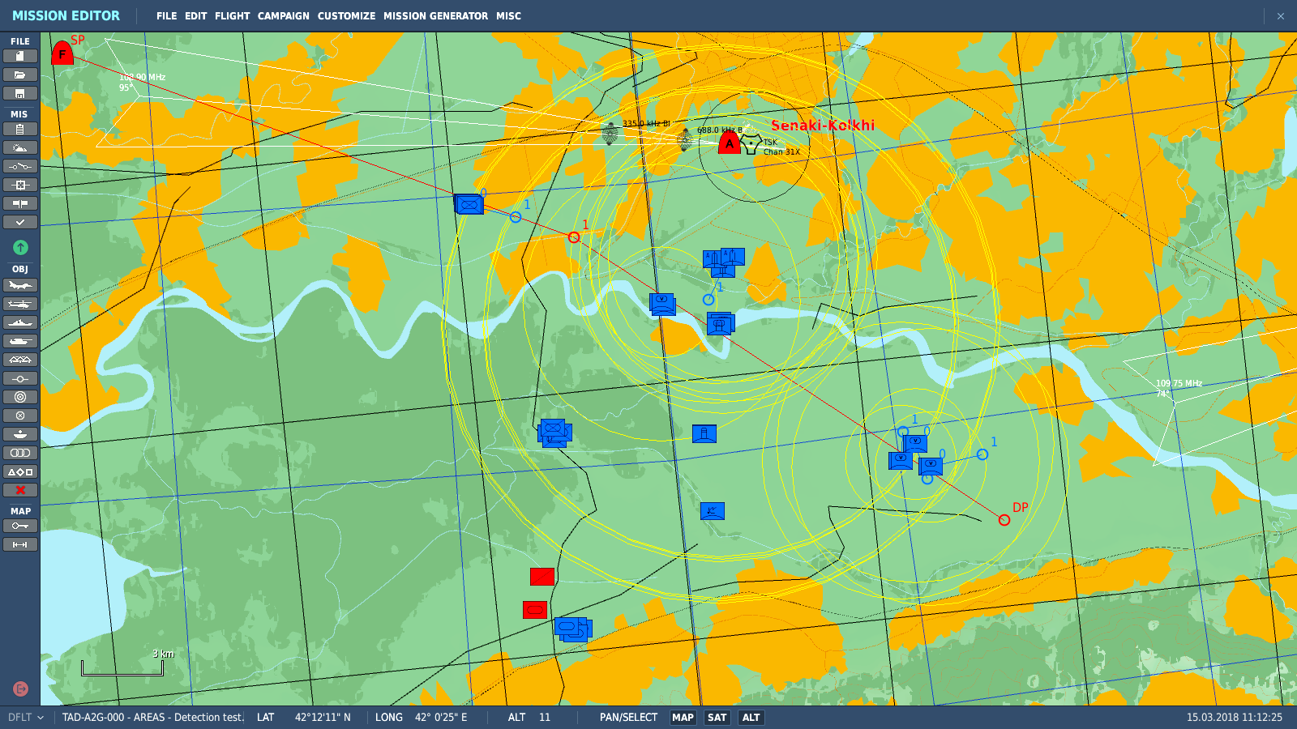
situation
Blue enemy Target Area

Slide 4
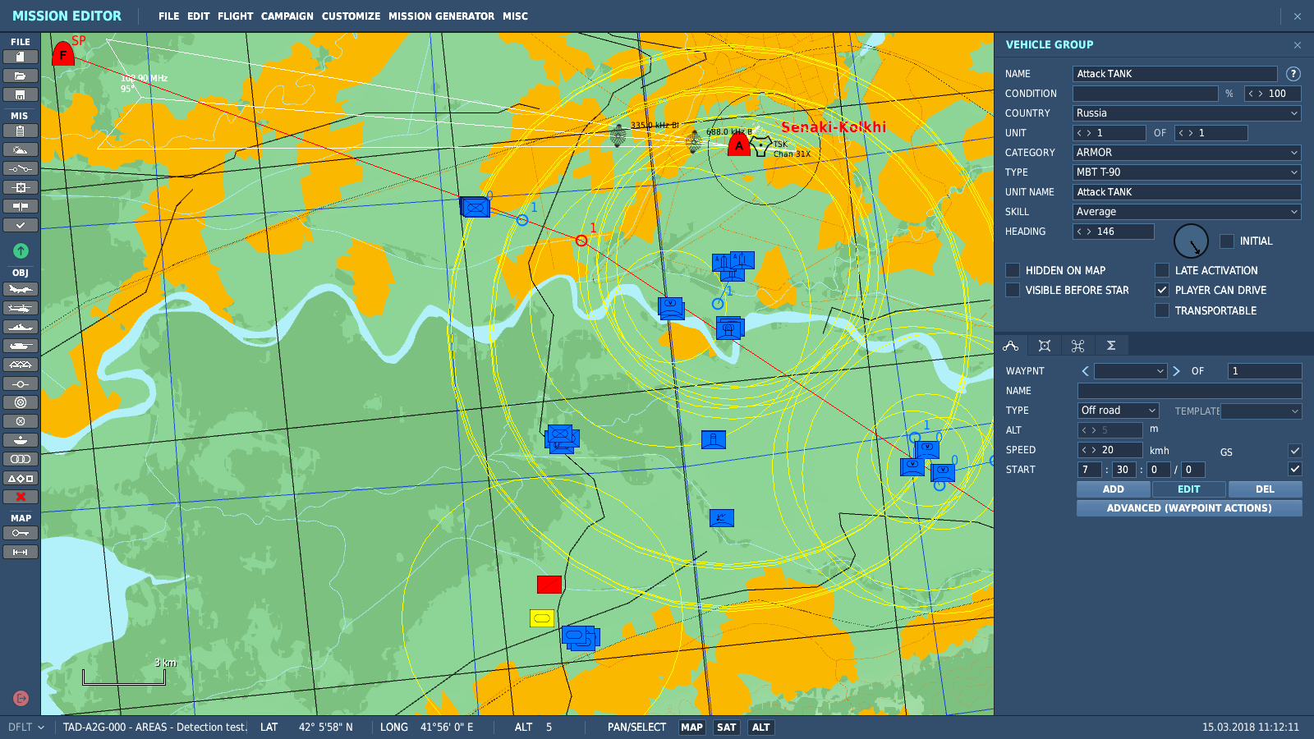
recce and attack
Reconnaissance (RecceSet)
Attack Units for Players (AttackSet)

Slide 5
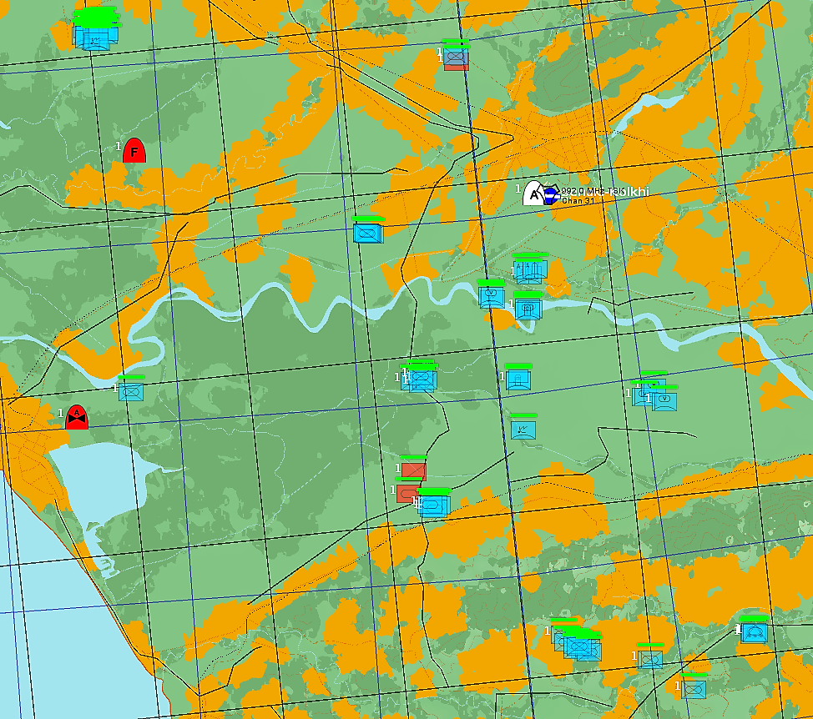
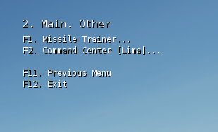
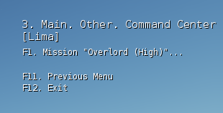
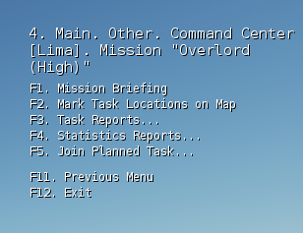
detection and menus
SEAD.003
Detections
SEAD.005
BAI.001
SEAD.004
Detections
CAS.002

Slide 6
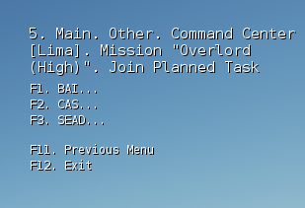
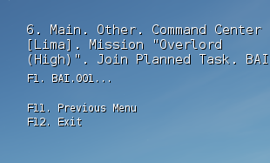
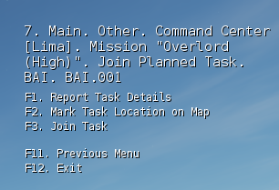
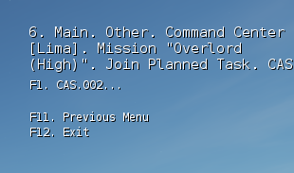
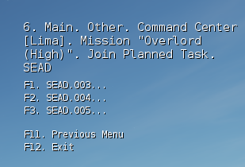
task type menus
SEAD.003
Detections
SEAD.005
BAI.001
SEAD.004
Detections
CAS.002

Slide 7
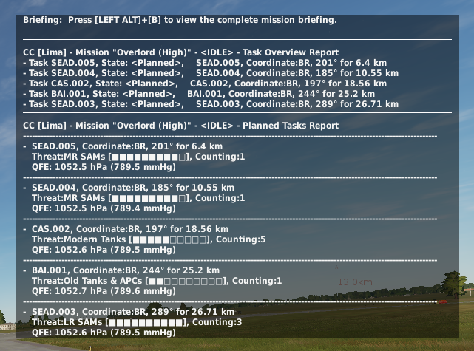
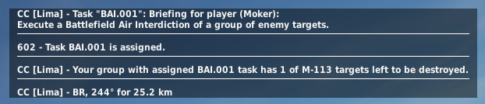
task messages
SEAD.003
SEAD.005
BAI.001
SEAD.004
Task Reports
Messages After Join Task
CAS.002

Slide 8
tactical situations

Slide 9
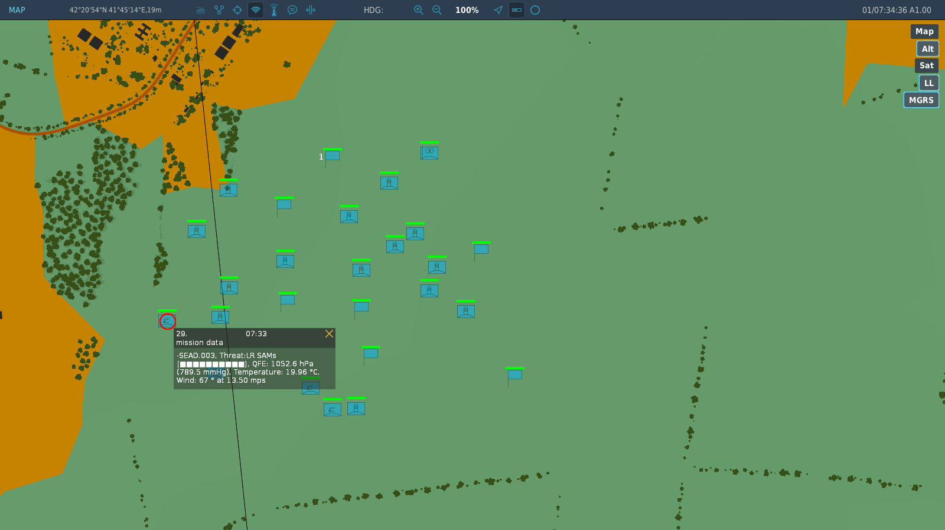
tactical situation: sead task
SEAD Task
Once all Radar Emitting Units have been destroyed, the Task will convert into a BAI or CAS task!
A CAS and BAI task may be converted into a SEAD task, once a radar has been detected within the area!
Radar Emitters

Slide 10
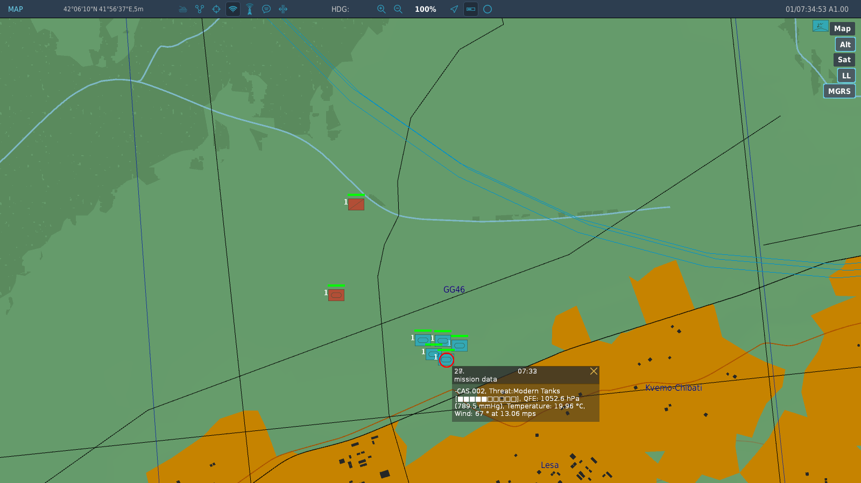
tactical situation: CAS task
CAS Task
After the detection of the CAS task, if the friendly Units are destroyed, the CAS task will convert into a BAI task!
Friendly within 6km from enemy
Friendly must be a ground Unit!

Slide 11
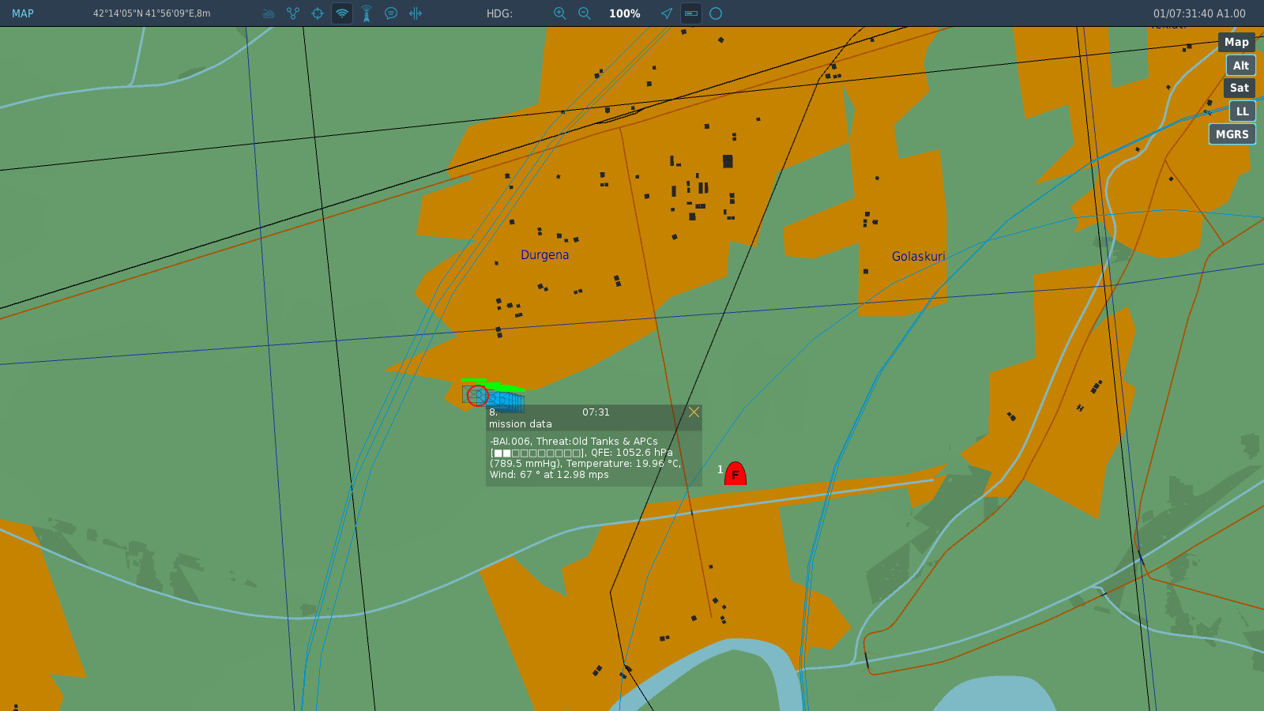
tactical situation: BAI Task
An Air Unit is not a Ground Unit! So BAI!
BAI Task
A BAI task may be converted into a CAS task if friendly Ground Units approach within 6 km range!

